Slide 1



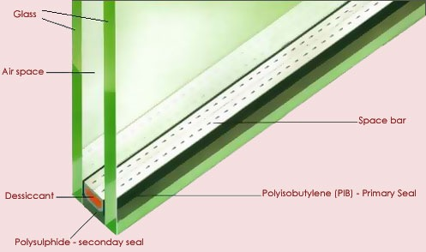
Sealed-Glass Proofs:
What can we do with SGX without confidentiality?
Florian Tramèr, Fan Zhang, Huang Lin, Jean-Pierre Hubaux, Ari Juels, and Elaine Shi.
Sealed-Glass Proofs: Using Transparent Enclaves to Prove and Sell Knowledge. EuroS&P ’17. (https://eprint.iacr.org/2016/635)
Notes:
Joint work with colleagues at EPFL, Cornell
In this talk, I’ll present our paper on Sealed-glass proof, or what can we do with SGX w/o conf.
As you may know, the conf guarantee provided by SGX is questionable. We proposed a new security model (TEE) that captures the situation with conf. is broken. And we explored what functionality can be realized on top of it. In particular, I’ll show that even without conf, we can still achieve a strong proof system, called sealed-glass proof (SGP).

Slide 2











Attested Execution with SGX properties, threat model, use-cases
Isolated execution environment on untrustworthy host
Confidentiality + Integrity + Authenticity
Outsource computation to untrusted cloud
Adversarial host / OS
key-exchange
𝚺intel[Build(X) || Data]
Enclave
Attestation:
Digital (group) signature over enclave program + add. data
Notes:
- Begin by a short introduction to trusted hardware, in particular the concept of attested execution
- Use SGX as a running example, but ideas apply to trusted hardware in a broader sense
- SGX enables the creation of “software enclaves”, isolated memory region, aims to provide conf, integrity, authenticity of program execution even when enclave resides on untrusted host
Threat model: Adversary has full control of software stack, hardware
Typical use-case: outsource computation to cloud
Enclave can sign messages (attestations) under a special secret key, trust hardware manufacturer
机密性，完整性，真实性
将计算外包给不可信的云端

Slide 3

Attested Execution with SGX properties, threat model, use-cases
Isolated execution environment on untrustworthy host
Confidentiality + Integrity + Authenticity
Outsource computation to untrusted cloud
Adversarial host / OS
key-exchange
𝚺intel[Build(X) || Data]
Enclave
Ek[data]
Ek[result]
Notes:
- Begin by a short introduction to trusted hardware, in particular the concept of attested execution
- Use SGX as a running example, but ideas apply to trusted hardware in a broader sense
- SGX enables the creation of “software enclaves”, isolated memory region, aims to provide conf, integrity, authenticity of program execution even when enclave resides on untrusted host
Threat model: Adversary has full control of software stack, hardware
Typical use-case: outsource computation to cloud
Enclave can sign messages (attestations) under a special secret key, trust hardware manufacturer

Slide 4
SGX isolation is imperfect
Some resources are shared between enclaves and untrusted hosts, leading to
Cache-based Side Channels [1,2]
Branch History-based [3]
Page Fault-based
…
[1] https://arxiv.org/abs/1702.08719
[2] https://arxiv.org/abs/1702.07521
[3] https://arxiv.org/abs/1611.06952
Notes:
It is known SGX isolation is not perfect due to various side-channel.
Perfect isolation is challenging: resources are shared between trusted and untrusted parties. The root cause of various side channel attacks.
Clearing state is expensive on some case.

Slide 5
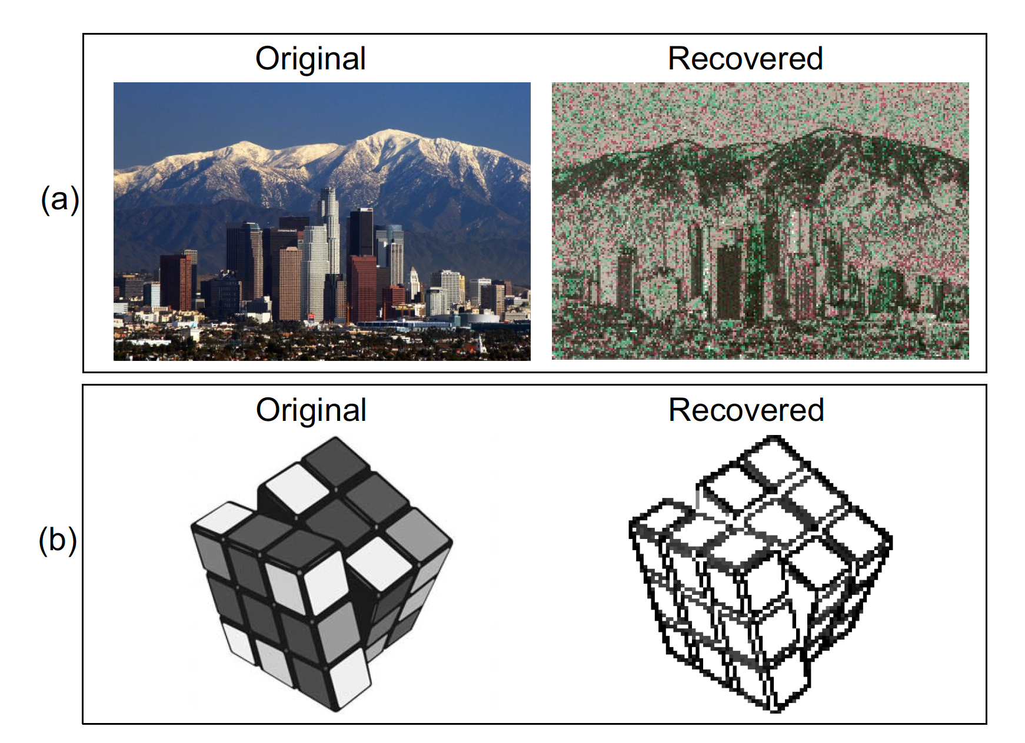

SGX isolation is imperfect
E.g., Page faults can be induced and seen by OS
Leaks memory access patterns
Seems more difficult to break integrity & authenticity!
Confidentiality is broken!
libjpeg attack from Y. Xu, W. Cui, and M. Peinado, "Controlled-Channel Attacks: Deterministic Side Channels for Untrusted Operating Systems", IEEE S&P, 2015
Notes:
- OS controls and can modify page tables
- Leaks data-access patterns (side-channel)
- Confidentiality is broken!
Seems more difficult to extend such attacks to break integrity / authenticity
For small crypto module like digital signatures, side-channel resistant is well-understood
Applying same protection to user code is difficult: minor overhead for specific computations but in general requires at least ORAM

Slide 6


New adversarial model
Model user enclave execution in SGX as Transparent Enclave Execution
TEE assumes unbounded leakage of information to host
Encompasses arbitrarily strong side-channel attacks
But correct execution and attestation
I.e., integrity, but not confidentiality
Adversarial host / OS
no secret code or data!
Enclave
𝚺intel[Build(X) || result of exec.]
Notes:
- Motivated by these attacks on execution confidentiality, we consider a weaker model:
- Assume confidentiality only for core crypto primitives (to get integrity and authenticity).
Justification: side-channel resistant implementations
Typical SGX use-case: bi-directional resource asymmetry (client has secret data, cloud has computational resources)
- New use-case: uni-directional asymmetry (party without SGX has no secrets)

Slide 7


Warmup: Verifiable Computing
Prover: “outp = prog(inp)”
E.g: PoET, MLaaS
FVC[P, V, prog]
inp
P
outp=prog(inp), inp
V
Notes:
Warmup by a simple case of VC that allows V to outsource computing to P.
V把计算外包给P
Both input and output are disclosed, thus allowing arbitrary leakage. No secret is involved.
Despite the limitation of no secrecy, VC is already useful.
MLASS：机器学习服务
采取捷径，使用预训练的神经网络来处理由主要云服务提供商提供的图像，视频，语音和自然语言数据。通过一个简单的API来访问预训练好的网络，为什么还要花时间和金钱自己去训练一个神经网络呢？
P：有SGX 的host
V：remote verifier
F：function

Slide 8

Zero-Knowledge Proofs
Prover: “I know some inp such that prog(inp)=true” w/o leaking inp
FZK[P, V, prog]
inp
P
outp=prog(inpP)
P
V
P’s device
Notes:
TEE can also realize ZK proofs where P wants to prove her knowledge of a witness to some relationship.
P向别人证明机密
Explain the protocol
Since P is the secret holder, the leaky enclave has to reside on P’s device. V only gets the output from P.
Enclave要在P的机器上，V只拿结果
Key observation: If the proof runs on the prover’s side, the leakage only goes to the prover herself. So doesn’t matter.

Slide 9
Sealed-Glass Proof (SGP)
Both P and V hold secrets.
FSGP[P, V, prog]
inp
P
inp
V
(*commit*)
outp=prog(inpP, inpV)
P
V
“open”
inp
P
Notes:
To generalize even further, we proposed SGP to capture the computation doable in a transparent enclave
In a SGP, both the prover and the verifier provide secrets. But V’s secret is ephemeral（短暂）.
Can prove stronger statements: Prover can prove her knowledge under interactive challenge.
SGP is a generic functionality that generalizes VC, ZK, Commitment.
It’s called sealed-glass proofs because the prover begins by committing to her input
密封玻璃盒证明.

Slide 10



Why “sealed glass” ?
Problem: P can observe inpV
FSGP[P, V, prog]
inp
P
inp
V
outp=prog(inpP, inpV)
P
V
Solution: P commits before seeing V’s input!
Notes:
Problem: prover gets to see verifier’s input
P can selectively choose inp after seeing V’s input and V can not tell. V doesn’t know whether inp_p is chosen before or after inp_v.
Need to make sure P can’t change it’s input when seeing V’s.
Solution: P commits first

Slide 11
Application: Bug bounty
progS(exploit) = "true" iff exploit compromises software S
E.g., SQL injection attack
FSGP[P, V, progS]
exploit
Random
DB
progS(exploit, c) = "true" ?
seller
buyer
"open"
exploit
Notes:
- Bug 赏金
- Program loaded into enclave acts as exploit checker (ideally prog is created by buyer)
- Example: For SQL injection, prog initializes a random user DB and checks if exploit allows seller to login
- Problem: exploit is trivial if content of DB is known (enclave is transparent)
Solution: seller provides exploit before DB is populated
Can use trusted hardware to prove knowledge of exploit (in ZK). Next step: Fair Exchange!

Slide 12
Application:
Knowledge Monetization
$Reward
exploit
software S
fair exchange
seller
buyer
Notes:
Goal: convince buyer of knowledge of exploit without revealing it (for later reward)
We’ve achieved the first step: proof of knowledge using SGP. The other building block is fair exchange.
知识货币化

Slide 13



ZKCP: ZK Contingent Payment
Proof=ZK-PoK{
progs(exploit) = true &&
c = Enc(k, exploit) &&
h = Hash(k)
}
Buyer initiated version:
Reward $R
iff progS(expl)=true
exploit
progS
Expensive
offer=(Proof, h, c)
Abort!
Abort!
seller
buyer
hashlock(h, seller, $R)
k
exploit=Dec(k, c)
blockchain
Notes:
Maxwell had a protocol enabling Bitcoin transaction contingent on ZK proofs.
In a sense, it’s a form of commit-and-prove functionality. The seller commits to exploit and then prove something about it.
ZKCP lacks necessary marketplace properties
zk proofs for non-trivial applications can be prohibitively expensive
malicious sellers can tie up B’s money by aborting after sending the offer.
B can abort after receiving the offer (B still learns that there exists a bug)
Enc：一个对称加密方案
H：加密哈希函数

Slide 14


End-to-end bug-bounty system
FSGP[P, V, ]
Reward $R
progS
progS
exploit
✔
exploit
Blockchain
Bounty contract
buyer
seller
$Reward
progS
Notes:
Can’t rely on the smart contract to run prog because its state is public.
Run a SGP between the seller and the contract

Slide 15
End-to-end bug-bounty system
FSGP[P, V, ]
progS
Blockchain
Bounty contract
buyer
seller
$Reward
progS
✔
exploit
Fair exchange: $Reward for exploit against S
Notes:
Contract verifies attestation validity, and sends reward to seller

Slide 16
End-to-end bug-bounty system
Properties:
Fair exchange: $Reward iff delivered exploit
Confidentiality: exploit encrypted under public key of buyer
Guaranteed payment*: buyer will pay at least one valid seller before specified deadline
Prevents bug-bounty competition from being unfairly terminated
*ZK-snark-based Bitcoin systems can't achieve this one
Notes:
Strong property obtained from smart contracts: guaranteed payment
Buyer’s funds are put in escrow until a seller arises (or timeout occurs).
No interaction required from Buyer after contract is set up!
Can talk more about why properties 1&2 are achievable with Bitcoin but not 3

Slide 17
Marketplaces for
what kinds of bugs?
In principle, for any system executable / simulatable in enclave
In paper:
SQL injection attacks
Facebook Proxygen library fronting SQLite
Certificate Validation Logic conflicts
OpenSSL and mbedTLS
MITM attacks against TLS handshakes
Simulation environment in which exploit attacks simulated handshake between server and honest user
Notes:
Challenge: port exploit environment to SGX with little boilerplate
What if the boilerplate contains a bug?
Differential testing
We couldn’t implement MITM attack in SGX yet, because no support yet for dynamic loading

Slide 18
Summary
Transparent enclave execution (TEE)
Lots of fun things can be done without confidentiality!
Natural extensions to allow for some functionalities to remain hidden from host (e.g., crypto primitives)
Sealed-Glass Proofs
Generalizes ZK-proofs, commitments, VC
Combining SGX with smart-contracts
Can provide guarantees (e.g. fair-exchange) not achievable with “traditional” crypto
Difficult to get right! Both formally and in practice
Sealed Glass Proofs
https://eprint.iacr.org/2016/635

